Slide 1

Mission India
Theological Seminary, Nagpur

Slide 2
Vision
“To equip young men and women to become Christ-like leaders for grassroots evangelism & Church planting in the unreached villages and cities of India & beyond.”

Slide 3
Mission
Our mission is to train men and women to demonstrate excellence in academics, spiritual and missional by offering biblical, theological and contextual educations in order to make Gospel relevant in communities in India and beyond.

Slide 4
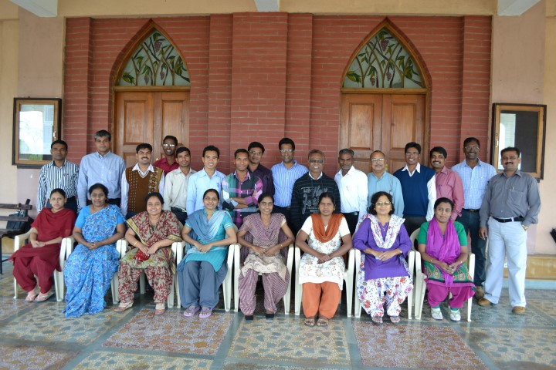
Residential Faculty

Slide 5
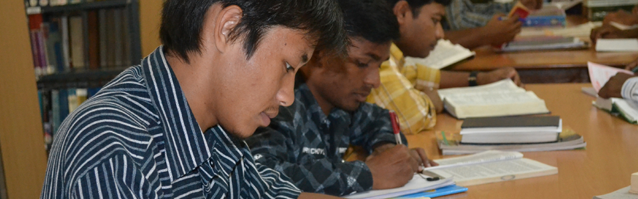
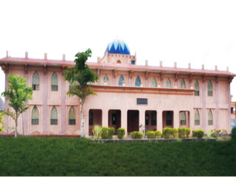
Library
40000 volumes

Slide 6
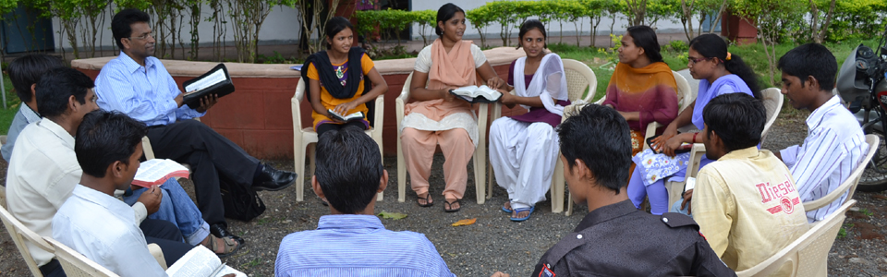
Discipleship Program

Slide 7
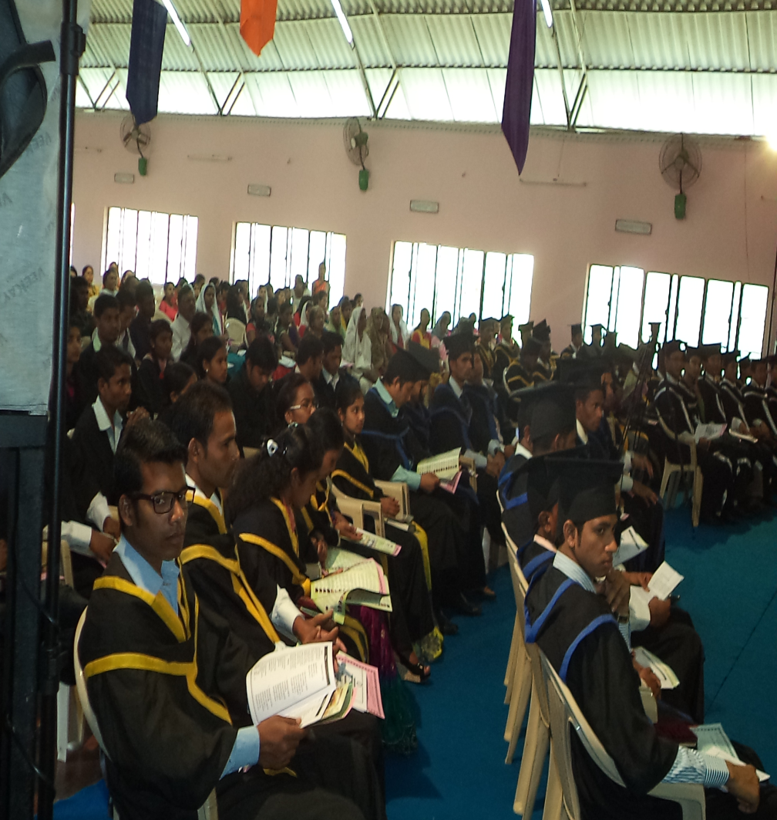
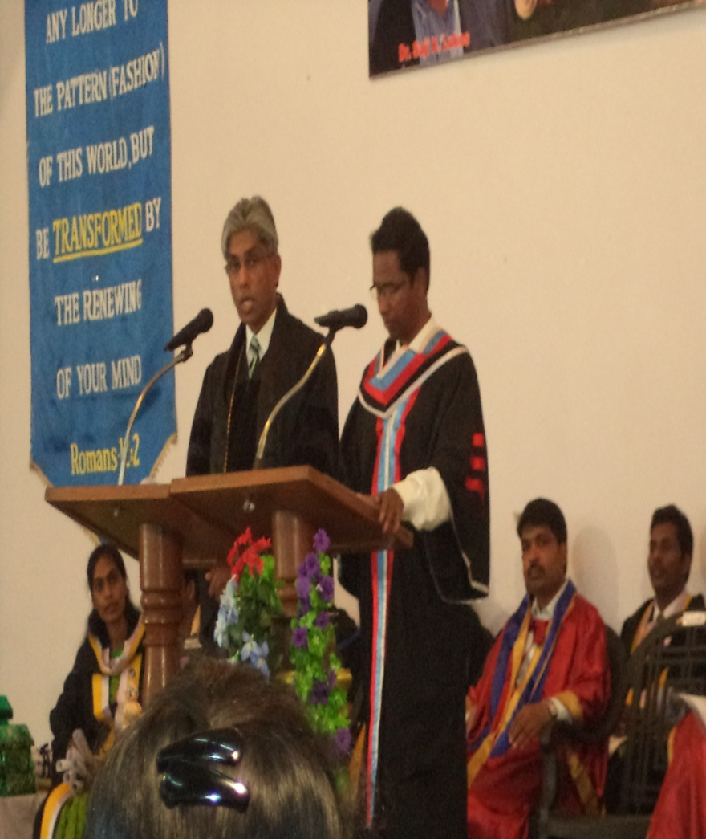
Graduation
65 Graduated in 2015

Slide 8
MATUL Update
6 students are in MATUL program at this moment. They are doing their intern courses. They supposed complete by this academic year, but could not.
MATUL program in MITS is offered through modular mode whereby the students come to MITS during the class hours and do their assignments while in their home by visiting library and slums nearby them.
MITS has more than eleven faculties, who can teach up to Master level programs.
When the students on day-scholar basis are found inability and difficulty to complete their library and field works as to the course requirements, MITS is seriously thinking to integrate MATUL courses into residential program.
Discussion in going on to integrate either in to B.Th. or M.Div. program. If not possible, it will look for grassroots training option

Slide 9
Recruitment Procedure
Every year, MITS appoints a recruitment coordinator, who further contacts Mission India State coordinators and Mission India Bible Centers’ Principal for induction of students for MITS.
Every faculty is asked to contact their friends and pastors for the induction of students.
Advertisement in the magazines and local news papers is done.
Mission India pastors working all over India are asked to send students for MITS.
Everyone involved in recruitment are given phone and internet grant.

Slide 10
Fund Raising System
Students are asked to pay possible fees.
Pastors are requested to raise fund for the students they send.
Conference Hall of MITS campus is given on rent to various organizations.
Mission India has a fund raising committee, who takes possible step for raising fund for the entire projects of Mission India.
Reaching Indians Ministries International (RIMI) in USA has a fund raising team to raise fund for the entire projects of Mission India.
Most of the needs are met from the funds raised by RIMI at this moment.

Slide 11
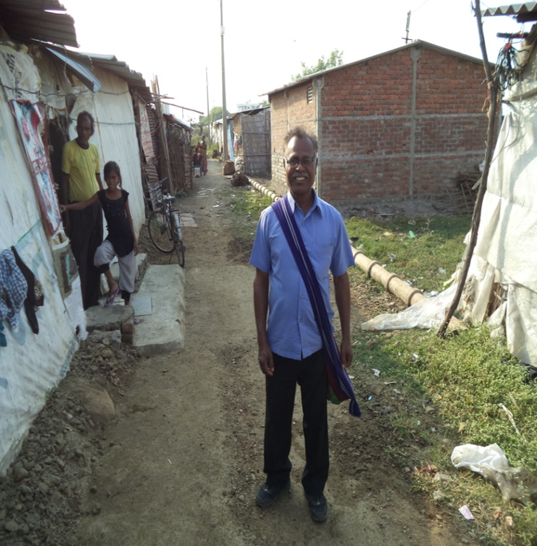
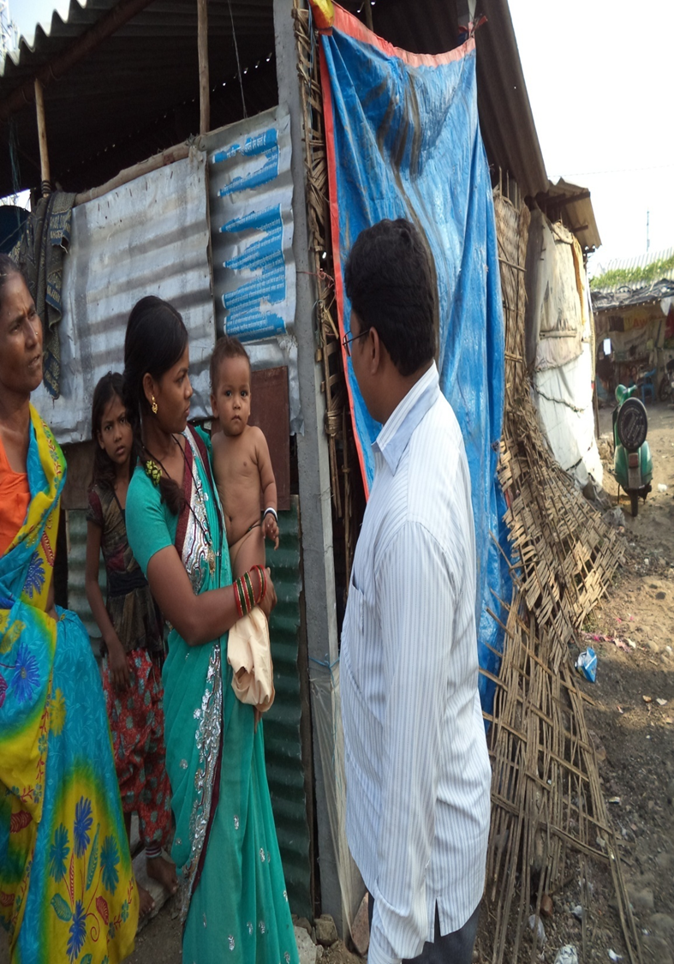
Students in the Slums doing their internship

Slide 12
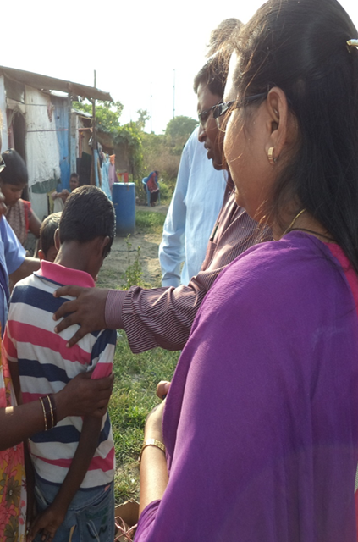
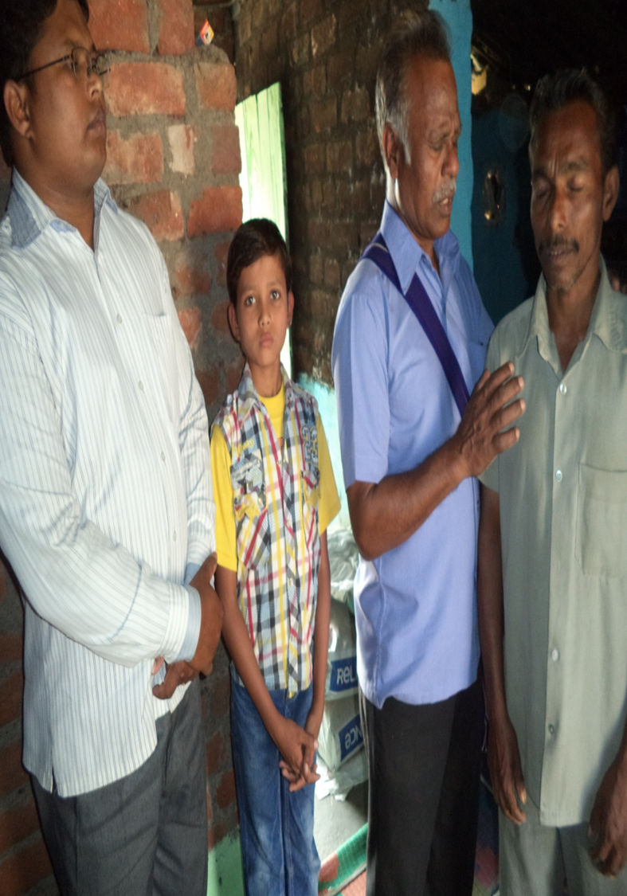
Students in the Slums doing their internship

Slide 13
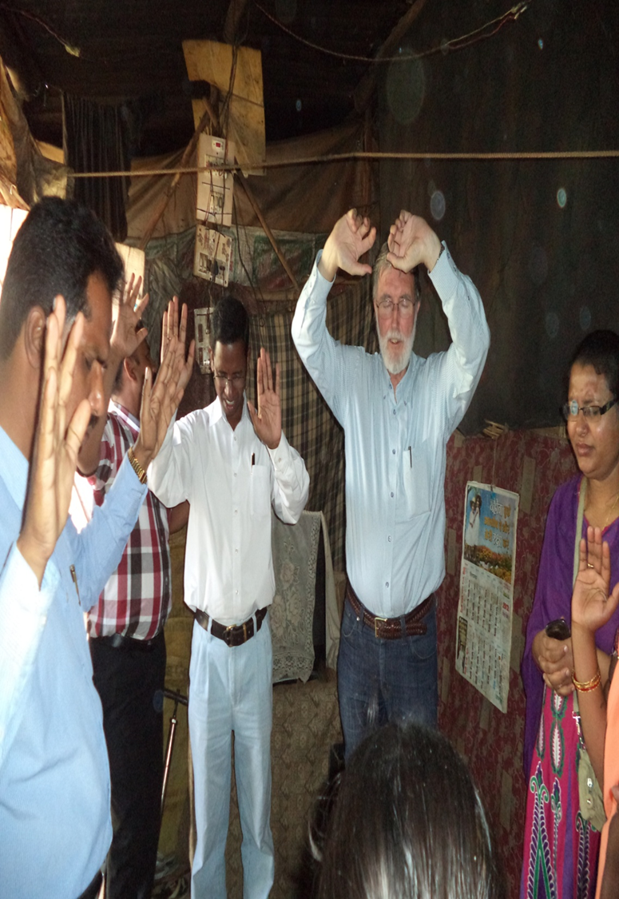
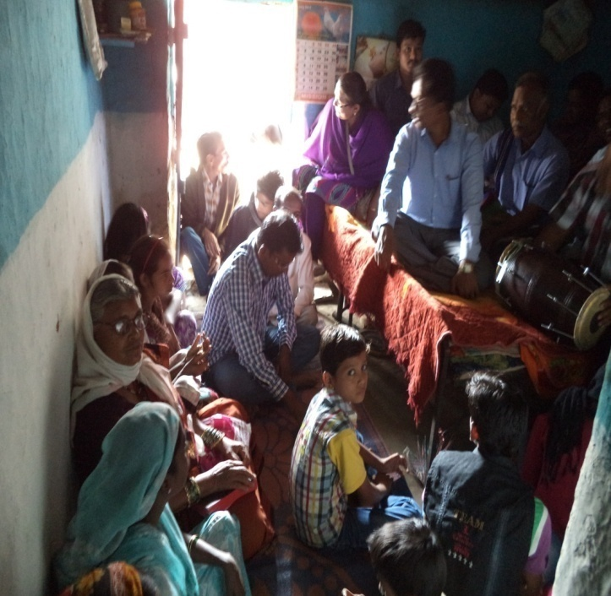
Dr. Viv’s last visit to Nagpur slums

Slide 14
Class on Community Economics
Dr. Viv Grigg with
MITS Faculty

